Slide 1
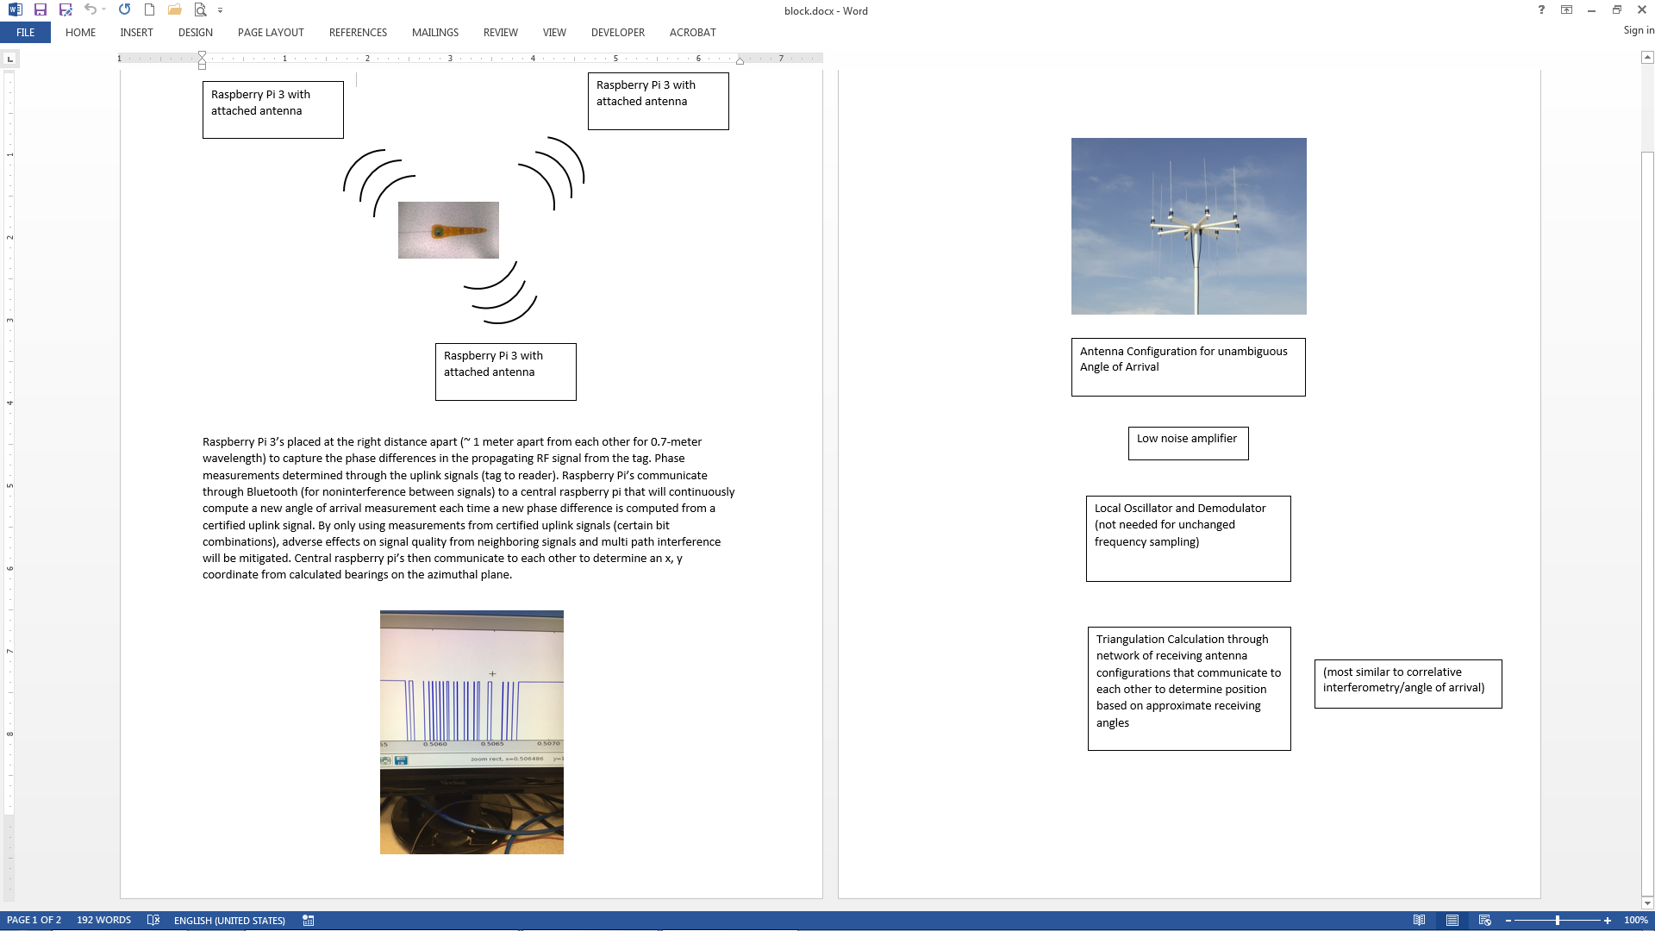

Slide 2
Transceiver/Tx
Receiver01/Rx
Receiver03/Rx
Receiver02/Rx
Main station
base station 01
base station 02
base station 03

Slide 3
For the transceiver and receiver, we want to use CC1310. The most distance with less power of this chip is about 20km. Which we can build a very large test area. The transceiver will put on the bird. It will have a scheduled time to send signal. For example, every five minutes. The scheduled time is in order to save the energy on the transceiver and make it run as long as possible.
All receivers will have same time schedule. Since the transceiver send the signal, the timer in receiver will start counting. Then when the receiver receive the signal, record the time and send to the base station.
For the base station, I suggest using Raspberry Pi 3 MODEL B, it is most powerful Raspberry PU in the market right now. The function of base station is to calculate the location of transceiver. With the time record by the receiver, we can calculate the distance between receiver and transceiver, but we don’t know the direction. My idea is build a 3D coordinate system for each base station. Use the coordinate system to locate the transceiver. Then send to the main station and combine the data. Finally get the location of bird.

Slide 4
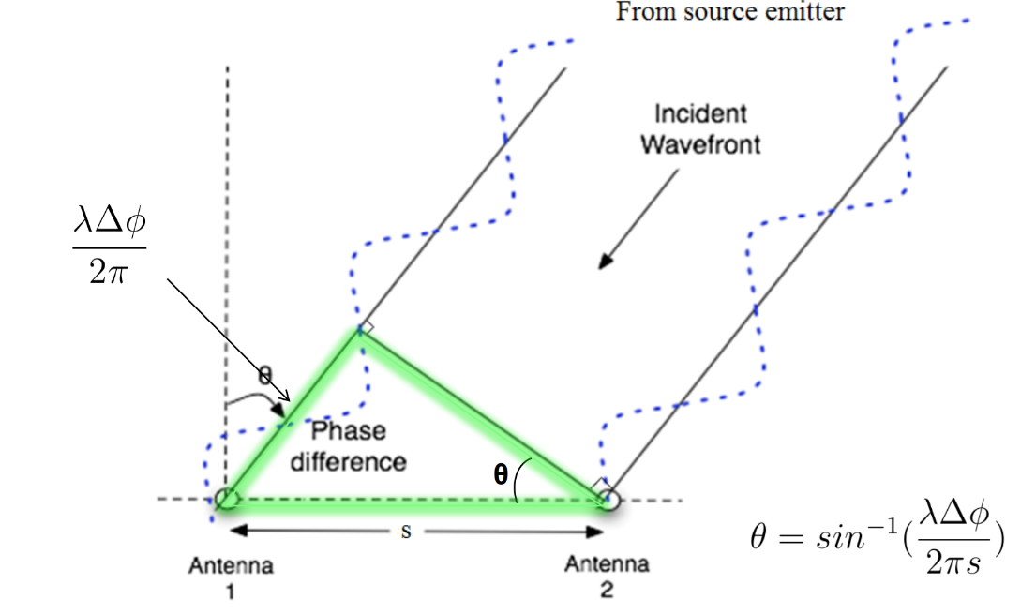
Phase Interferometry
Local
Oscillator
Antenna 1
Mixer
CC1310
ADC
Antenna 2
Mixer
CC1310
ADC
DF Algorithm running on RaspberryPi
Antenna 3
Mixer
CC1310
ADC
Ideal adapted from
Lincoln Labs
Notes:
TDOA

Slide 5
Amplitude-based (RSSI) angle of arrival

Slide 6
Time difference of arrival (TDOA)

Slide 7
Phase interferometry

Slide 8
Requirements and constraints
Short range (100-300 m between receivers)
Extremely simple transmitter design (lightweight, low power)
System can operate in cluttered environments (multipath interference)
System can operate with ~50 Txers
High spatial accuracy (~5 m) triangulation results
Low cost receivers (COTS components)
Low power consumption of receivers

Slide 9
Russell? Mei?
Peidong
Local
Oscillator
Demodulator??
Antenna 1
Mixer
CC1310
ADC
Antenna 2
Mixer
CC1310
ADC
DF Algorithm running on RaspberryPi
Antenna 3
Mixer
CC1310
ADC
Notes:
TDOA

Slide 10

Russell? Mei?
TRX 1
Peidong
Automated phase-based telemetry receiver system
TRX 2
Nathan
GPS
RxTx communication protocol
Nathan
Compass
Energy harvesting
Time-keeping,
coordination w/txrs
coordination w/ rxrs
localization of receivers
Julian
Orienting antenna elements
Julian
Node-to-node VHF uplink
TRX3
Triangulation algorithm
Uses RSSI?
Machine learning w/ calibration beacons?
TRX4
Bluetooth / VHF uplink to central hub
Mei? Russell?

Slide 11
5 + X s
5 min – (5 + X s)
Tx
Rx from mobile nodes
5 s
X (?) s
Ground node
(acquire or sleep mode)
Tx countdown signal (5 s)
Tx commands
e.g. 3.9917 & checksum
e.g. 2.5628 & checksum
0.0000
Y IDs
Y commands
*Will need a data upload mode too
Checksum (opt.)
Global time
Sleep command
Y
Sleep length
X
Listen for tags
X
Y
X
N
Default?
N
Special commands for Y tags
*Give mobile nodes way to check that they have a good link
*All mobile nodes sync’d here
*Keeps all mobile nodes from TXing when system isn’t monitoring
*Default mode just has any tag within range of sync signal transmit at its scheduled time
*Special commands allow a subset of tags to be told to go to sleep, switch to different mode (e.g. to upload sensor data on different channel), etc.
Mobile node diagram to follow. Mobile nodes should sleep just under 5 s (ensuring they will hear a ground node transmission at least once if it is in range), then wake long enough to receive a single countdown signal from a ground node. Once they have received a countdown signal, and the checksum demonstrates a good link, update global time (it will have drifted over the last 5 min), then listen for rest of commands. Once commands received use global time, received command, and (assuming the command includes a simple transmit instruction) pre-programmed transmission time delay to send ID during the ground node’s ~5 min RX period.

